Slide 1
Sentiment Analysis of twitter Reviews
Name : darpan , Rudra Roll NO : 11723210052 ,11723210031 College Name : SRM University Haryana GUIDE name : Geetika Tikoria

Slide 2
Introduction
This project focuses on leveraging machine learning techniques to perform sentiment analysis on Twitter CHATGPT reviews. The goal is to automatically classify reviews as positive, negative, or neutral, thereby providing a scalable and efficient solution to analyze public opinion. This project aims to analyze and classify the sentiment of tweets related to ChatGPT using two distinct natural language processing techniques: VADER and RoBERTa. The project began by collecting a dataset of tweets that mention “ChatGPT.” The raw data was then cleaned and preprocessed. After preprocessing, two sentiment analysis models were applied:
Why we chose this project - In the age of digital commerce, online reviews have become a crucial factor influencing consumer purchasing decisions. Among e-commerce platforms, Twitter hosts millions of user-generated product reviews, offering valuable insights into customer satisfaction and product performance. However, manually analyzing such a large volume of textual data is impractical.
Scope - This project aims to apply a machine learning-based system capable of analyzing and classifying the sentiment of Twitter reviews.

Slide 3
Problem Statement
With the exponential growth of e-commerce, platforms like Twitter receive millions of customer reviews daily. These reviews contain valuable insights into user experiences and product quality. However, manually analyzing such a vast amount of unstructured text data is time-consuming and impractical. There is a need for an automated system that can accurately analyze the sentiment expressed in these reviews. This project aims to apply a machine learning model that can classify Twitter reviews into sentiment categories such as positive, negative, or neutral, enabling businesses to gain meaningful insights from customer feedback and improve decision-making.

Slide 4
Objectives of the Project
This project focuses on sentiment analysis of Twitter data related to ChatGPT, aiming to understand public opinion using two different approaches: VADER and RoBERTa. Tweets were collected, preprocessed, and analyzed to classify sentiments as positive, negative, or neutral. VADER, a rule-based model, provided quick and interpretable results, while RoBERTa, a deep learning model, offered more accurate and context-aware sentiment classification. The comparison highlights the strengths and limitations of each model in analyzing social media text and provides insights into public perception of ChatGPT.

Slide 5
Technology Stack – Machine Learning
VADER Sentiment Scoring - We are using NLTK's Sentiment Intensity Analyzer to get the neg/neu/pos scores of the text. This uses a "bag of words" approach, Stop words are removed, each word is scored and combined to a total score.
Roberta Pretrained Model - RoBERTa (Robustly Optimized BERT Approach) is an advanced NLP model. Pretrained on massive corpora, so it understands language very well. Captures contextual relationships between words, unlike traditional models. Easily fine-tuned on your dataset (e.g., Amazon reviews) for classification tasks.

Slide 6
System Architecture / Design
Data Collection: We have taken the Twitter data about ChatGPT from publicly available datasets - Kaggle datasets
Text Cleaning: Removing stopwords, special characters, and irrelevant text.
Tokenization: Splitting text into individual words or tokens.
Feature Engineering: Converting the cleaned text into features by tagging part of speech to token, the process of assigning grammatical categories (like noun, verb, adjective, etc.) to words in a text.
Machine Learning Model : Application of models to our collected data
Prediction: After applying the model, the system is capable of predicting the sentiment of new, unseen reviews. The model will output one of the following sentiment labels: Positive, Negative and Neutral
Visualization and Reporting : Using graphs

Slide 7
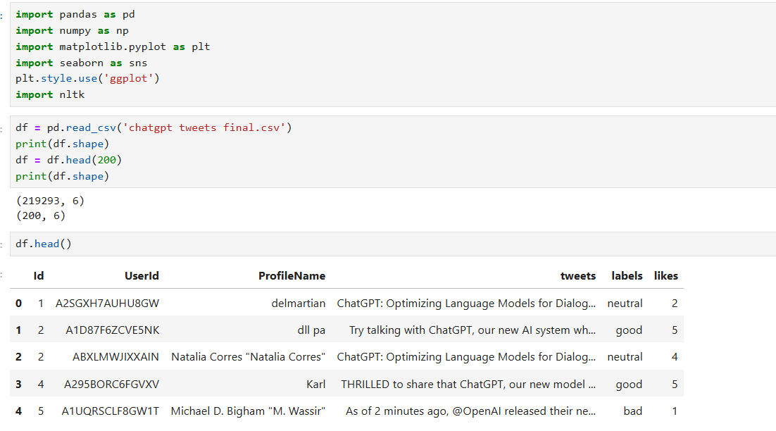

Implementation / Module Description

Slide 8
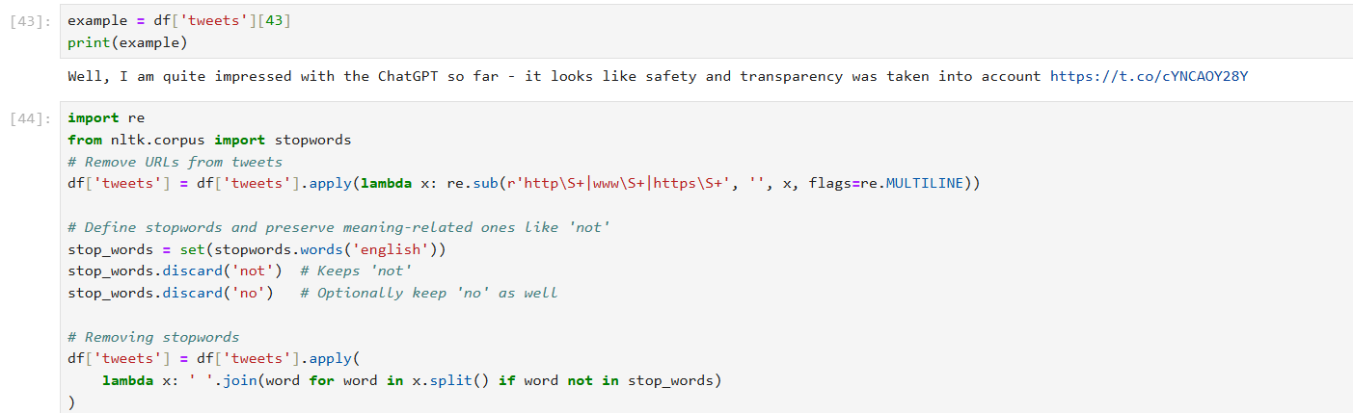
Implementation / Module Description

Slide 9
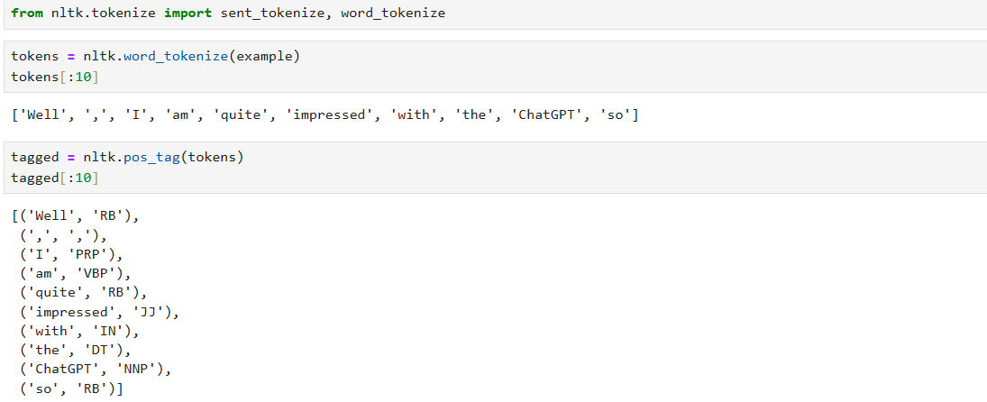
Implementation / Module Description

Slide 10
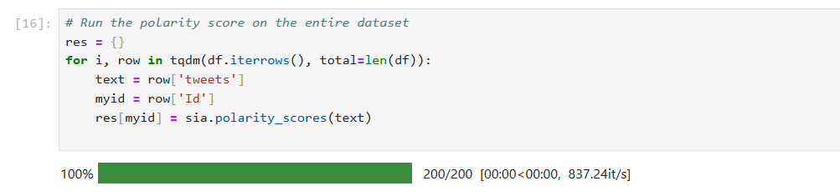
Implementation / Module Description VADER :

Slide 11
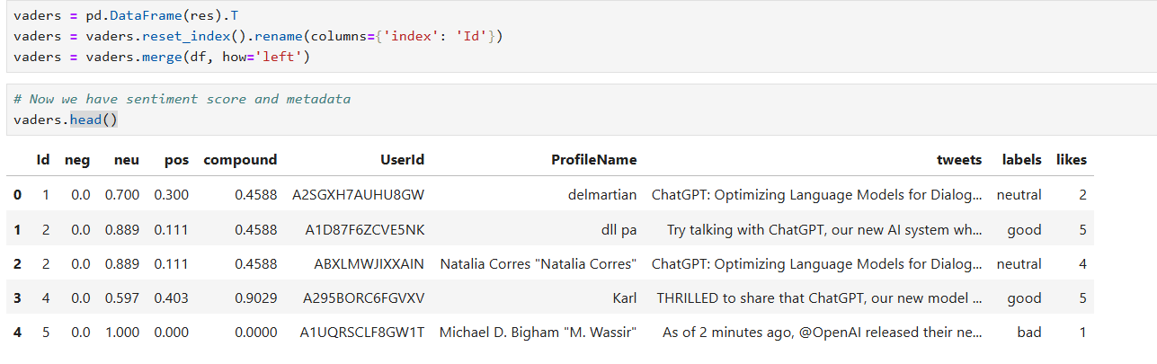
Implementation / Module Description

Slide 12
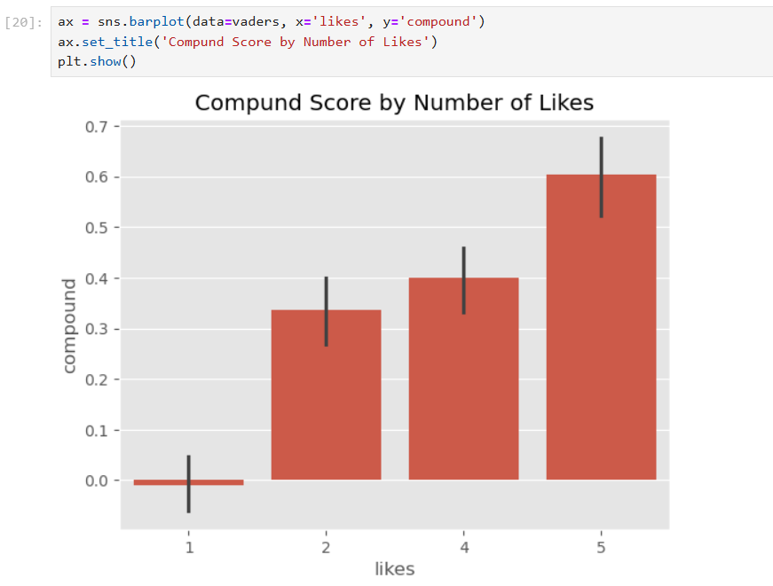
Implementation / Module Description

Slide 13
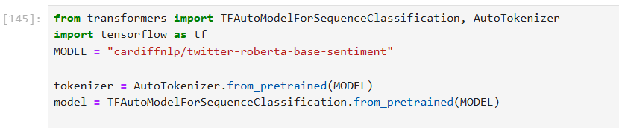
Implementation / Module Description ROBERTA :

Slide 14
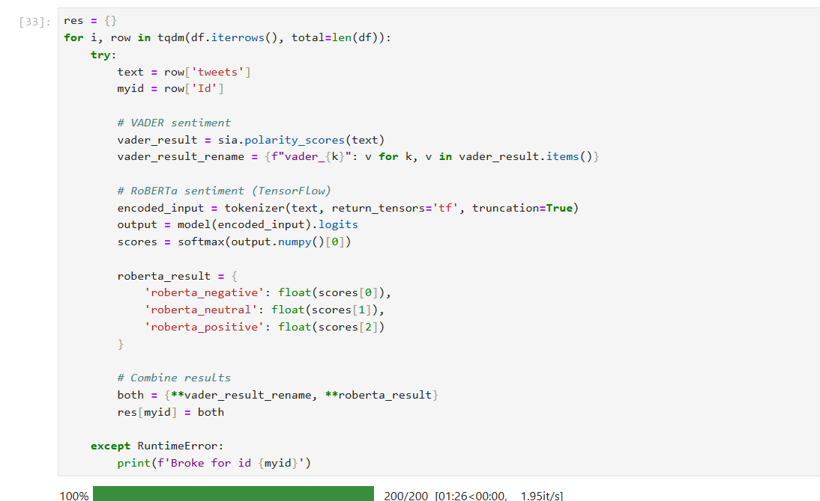
Implementation / Module Description ROBERTA :

Slide 15
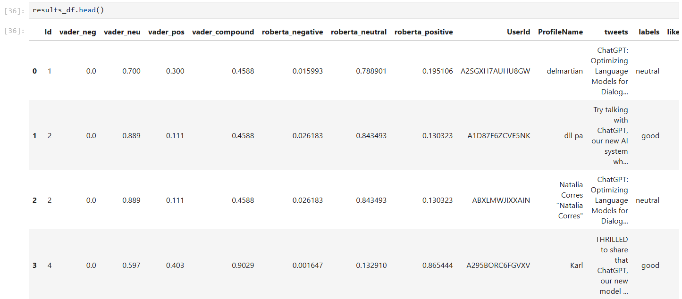
Implementation / Module Description

Slide 16
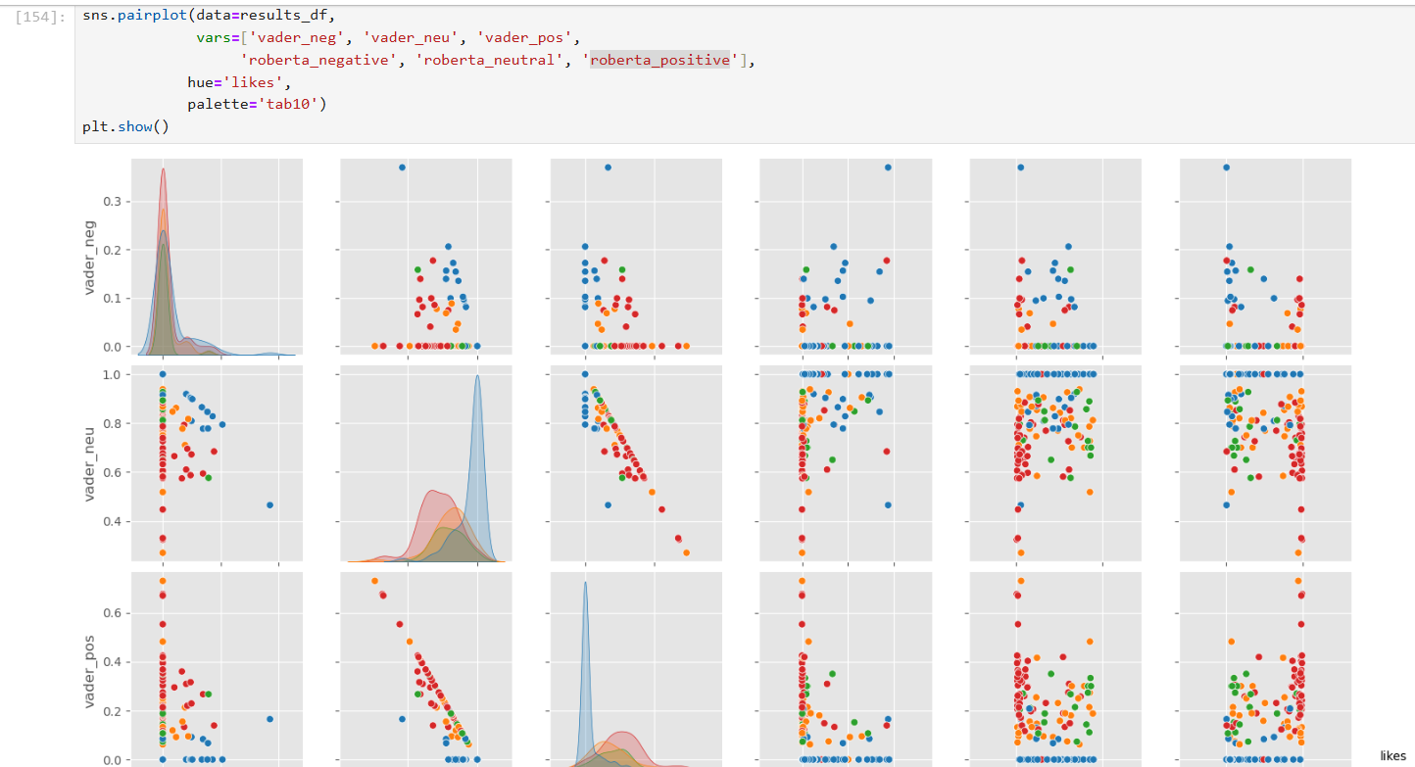
Implementation / Module Description Comparison between roberta and vader analysis

Slide 17
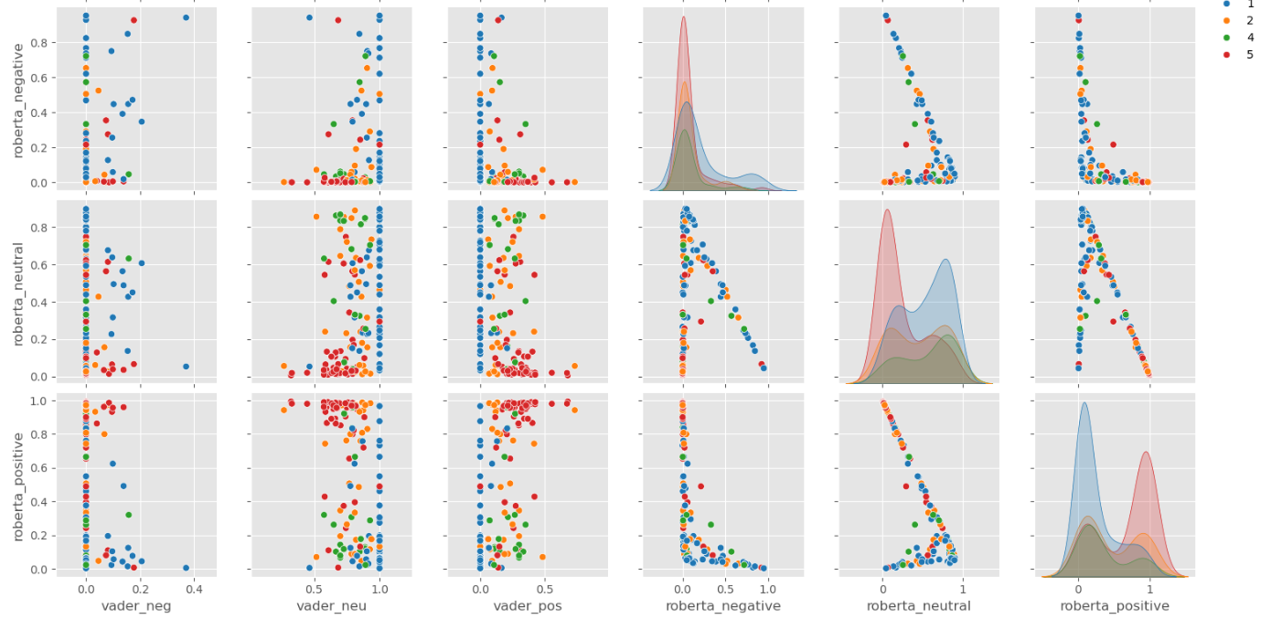
Implementation / Module Description Comparison between roberta and vader analysis

Slide 18
Conclusion
In this project, we compared two sentiment analysis approaches: VADER, a rule-based sentiment analysis tool, and RoBERTa, a transformer-based pretrained deep learning model. The comparison highlights clear differences in performance, complexity, and suitability for various use cases.
In summary, VADER is suitable for quick, real-time applications with limited resources, while RoBERTa is the preferred choice for high-accuracy sentiment analysis tasks where performance is a priority. The selection between the two should be based on the specific requirements and constraints of the application.

